Slide 1
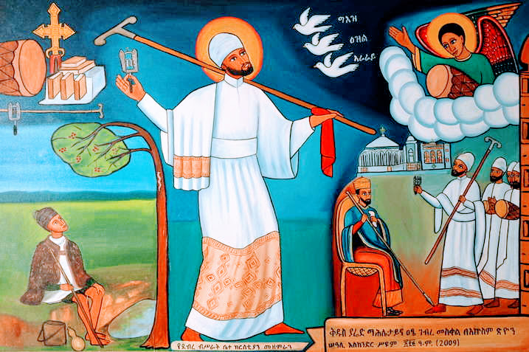
ናይ ኤርትራ ኦርቶዶክስ ተዋሕዶ ቤተ ክርስቲያን
Nay Eritrea Orthodox Tewahdo Biete Kristiyan
Eritrean Orthodox Tewahdo Church
1

Slide 2
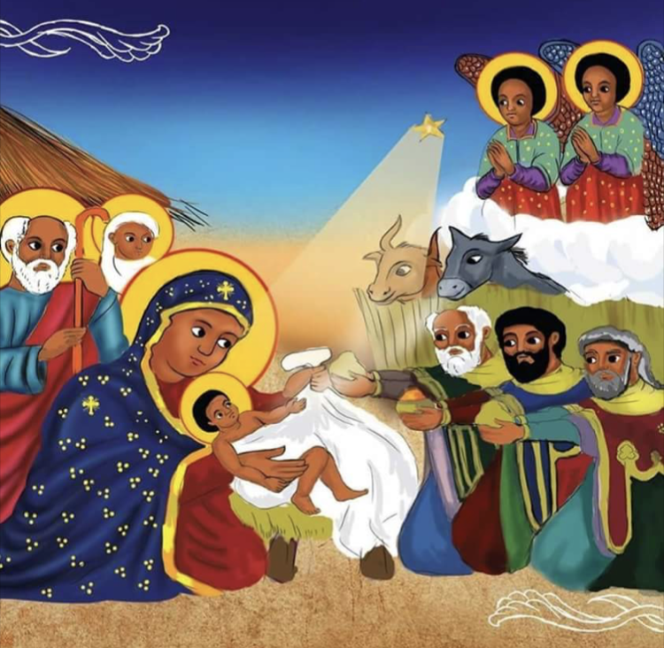
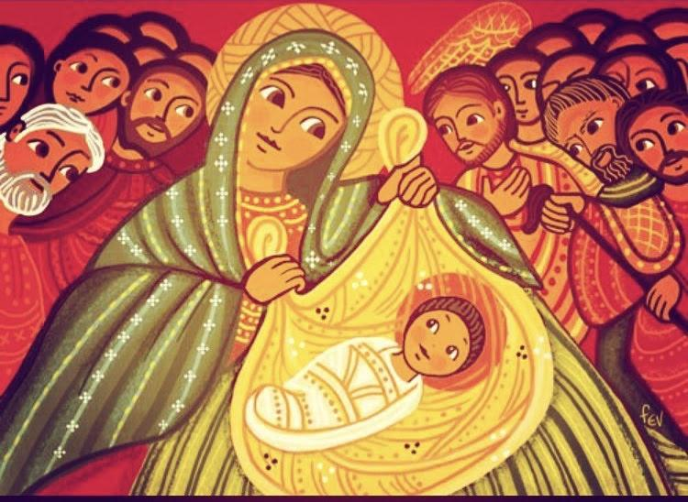
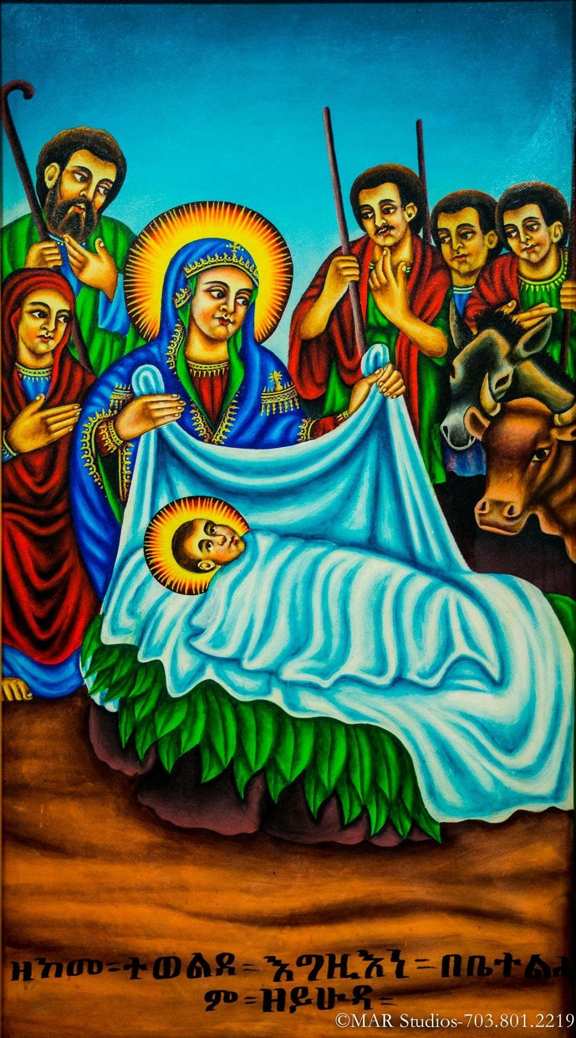
ማኅሌት ዘልደት
Mahliet ze-lidet
Psalmody of the Nativity

Slide 3
ሚካኤል ሊቀ መላእክት ሰአል በእንቲአነ ወቅዱስ ገብርኤል አዕርግ ጸሎተነ።
፬ቱ እንስሳ መንፈሳውያን ሰባሕያን ወመዘምራን ሰአሉ በእንቲአነ ፳ወ፬ቱ ካህናተ ሰማይኒ አዕርጉ ጸሎተነ።
Mikael līqe mela’ikt se’al be-intīane we-qidus Gebriel a’irig tselotene.
arba’itu insisa menfesawiyan sebahayan we-mezemiran se’alu be-intī’ane isra we-arbaitu kahinate semaynī a’irigu tselotene.
St. Michael, the Archangel plead for us and St. Gabriel raise our prayers to the Lord.
The 4 Beasts, spiritual ones, praisers and singers, plead for us; the 24 Priests of the heavens raise our prayers to the Lord.

Slide 4
ነቢያት ወሐዋርያት ጻድቃን ወሰማዕት ሰአሉ በእንቲአነ ምስሌክሙ ከመ ይክፍለነ መክፈልተ ወርስተ ለኵልነ።
ማኅበረ ቅዱሳን ወሰማዕት ሰአሉ በእንቲአነ መላእክተ ሰማይኒ አዕርጉ ጸሎትነ።
Nebiyat we-hawariyat tsadqan we-sema’it sealu be-inti’ane misliekimu keme ykfilene mekfelte we-riste le-kuiline
mahbere qidusan we-semait se’alu be-inti’ane melaikte semayni a’irigu tselotine.
Prophets and Disciples, Righteous ones and Martyrs, plead for us that he may give a portion and inheritance to us all.
The Union of Saints and Martyrs plead for us; Angels of heaven raise our prayers.

Slide 5
ማርያም እግዝእትነ ማርያም እግዝእትነ ወላዲተ አምላክ ሰአሊ በእንቲአነ እስመ ረከብኪ ሞገሰ በኀበ እግዚአብሔር።
ረከብኪ ሞገሰ መንፈሰ ቅዱሰ ወኃይለ ሰአሊ ወአስተምሕሪ ለነ ማርያም ወልድኪ ሣህሎ ይክፍለነ።
ኅበ ተርኅወ ገነት ወኅበ ተነጽፈ ዕረፍት ይክፍለነ ነህሉ ውስተ በዓቶሙ ለቅዱሳን።(፫)
Maryam igzi’itine weladite amlak sealu be-inti’ane isme rekebki mogese be-habe igzī’abhier.
rekebki mogese Menfes Qidus we-hayle sealu we-astemhirī lene Maryam weldki sahlo ykfilene.
habe terhiwe genet we-habe tenetsfe irefte ykifilene nehalu wiste be-atomo leqidusan.(3)
Our Lady St. Mary, the Theotokos, plead for us for you have received grace from God.
You (St Mary) have received grace of the Holy Spirit and power; plead and entreat Him for us, St. Mary, that Your Son may give us His Mercy
As the Garden of Eden was opened and tranquility was prepared; may He make us worthy to dwell in the Dwelling Place of His Saints. (3).

Slide 6
ነግሥ፤ Negs
Hear my prayers, Lord, hallelujah.
Hallelujah. And let my cry reach you, hallelujah.
Hallelujah and don’t turn your face from me. In my times of troubles, direct your ear toward me, hallelujah, hallelujah.
ስምዓኒ እግዚኦ ጸሎትየ ሃሌ ሉያ፥ ሃሌ ሉያ ወይብጻሕ ቅድሜከ ገዓርየ ሃሌ ሉያ፥
ሃሌ ሉያ ወኢትሚጥ ገጸከ እምኔየ። በዕለት ምንዳቤየ አጽምእ እዝነከ ኅቤየ ሃሌ ሉያ፥
Simanī igzīo tselotiye halie luya: halie luya we-ybitsah qdimieke geariye halie luya:
halie luya we’ītimīT getseke iminieye. be- ilete mndabieye atsmi izineke habieye halie luya:

Slide 7
ነግሥ፤ Negs
On the day which I call you, hear me speedily, hallelujah, hallelujah, forever and ever and ever.
Hallelujah this is the saying. We praise Him, He who was always there, God the sovereign/mighty.
Glorified and praised is He who made the world with one word.
Hallelujah: “praise ye the Lord”
ሃሌ ሉያ አመ ዕለተ እጼውዓከ ፍጡነ ስማዓኒ ሃሌ ሉያ፥ ሃሌ ሉያ ለዓለም ወለዓለመ ዓለም። ሃሌ ሉያ ዘውእቱ ብሂል ንወድሶ ለዘሀሎ እግዚኣብሔር ልዑል፥ ስቡሕ ወውዱስ ዘሣረረ ኩሎ ዓለም በአሐቲ ቃል።
halie luya ame ilete itsiewi’ake fTune sma’ani halie luya: halie luya le-alem we-lealem alem. halie luya ze-wi’itu bhīl.
nwediso le-zehalo igzīabhier liul. SIbuh we-widus ze-sarere kulo alem be-ahatī qal.

Slide 8
Portrayal of the Holy Trinity | Melki’a Silassie | መልክዐ ሥላሴ፤
Peace to Your fingers that aren’t distinguished from one another, to Your house, Trinity, whose wealth doesn’t end.
You have honored man after his sin made him fall from his former glory, the angels of the heavens saw today what they didn’t see before; for this angels are named servants of man.
ሰላም ለአጻብዒክሙ እለ እምአጽፋር ኢይትሌለዩ። ለቤትክሙ ሥላሴ ዘኢየኃልቅ ንዋዩ ።
አመ አብዓልክሙ ሰብአ ድኅረ አንደዮ ጌጋዩ፤ ዘኢርእዩ እምቅድመ ዮም መላእክተ ሰማይ ርእዩ ፤ ወአግብርተ ሰብእ መላእክት ተሰምዩ።
Selam le-atsabīkimu ile im-atsifar ī’yitlieleyu le-bietikimu Silasie ze-ī’yehaliq nwa’yu.
Ame abelkimu seb’a dhire andeyo giegayu; ze-īri’iyu im-qdime yom melaikit semay ri’iyu; we-agbrite seb’i melaikit tesemiyu.

Slide 9
ዚቅ፤ Zīq
ርእይዎ ኖሎት አእኮትዎ መላእክት፤ ለዘተወልደ እማርያም እምቅድስት ድንግል፤ ዮም ሰማያዊ በጎል ሰከበ።
riyi’wo nolot a’ikotiwo melaikit; le-zetewelde i’Maryam im-qidsit dngil; yom semayawi begol sekebe.
The shepherds saw Him, the Angels thanked Him; to Him who was born of Mary of the Holy Virgin; today the Heavenly laid in a manger.

Slide 10
ሰላም ለክሙ ሚካኤል ወገብርኤል ሱራፌል
ወኪሩቤል ዑራኤል ወሩፋኤል ሱርያል ወፋኑኤል
አፍኒን ወራጉኤል ወሳቁኤል ወሰላም ለቅዳሴክሙ
ትጉሀነ ሰማይ ዝክሩነ በፀሎትክሙ ።
selam le-kimu mīkaiel we-gebriel surafiel we-kīrubiel uraiel we-rufaiel suriel we-fanuiel afnīn we-raguiel we0saquiel we-selam le-qidasiekimu tiguhane semay zikirune be-tselotikimu

Slide 11
ሰላም ለክሙ ሚካኤል ወገብርኤል ሱራፌል ወኪሩቤል
ዑራኤል ወሩፋኤል ሱርያል ወፋኑኤል አፍኒን
ወራጉኤል ወሳቁኤል ወሰላም ለከናፍሪክሙ ከመ
ትእቀቡነ ተማህፀነ ለክርስቶስ በደሙ ።
selam le-kimu mīkaiel we-gebriel surafiel we-kīrubiel
uraiel we-rufaiel suriel we-fanuiel afnīn we-raguiel we-saquiel we-selam le-kenafirīkimu keme ti’iqebune temahitsene leKristos be-demu::

Slide 12
ሚካኤል ወገብርኤል ሱራፌል ወኪሩቤል እለ
ትሴብህዎ መላእክተ ሰማይ ሰአሉ ለነ አስተምህሩ ለነ
ቅድመ መንበሩ ለእግዚእነ ።
ሰላም ለከ ሊቀ መላእክት ሚካኤል ወዲበ ሰናይቲከ
አዲ ለሰብእ ሳህል አሐዱ እምእለ ይባርክዎ ለቃል
እዙዝ ዲበ ህዝብ ከመ ትተንብል በእንተ ስጋሁ ነበልባል ርእሰነ ከልል ።
mīkaiel we-gebriel surafiel we-kīrubiel ile ti’siebihiwo mela’ikte semay se’alu lene astemhiru lene qidme menberu leIgzī’ine::
selam leke līqe mela’ikt mīkaiel we-dībe senaytīke adī le-sebi sahil ahadu im-ile yibarikiwo le-qal

Slide 13
ሚካኤል ወገብርኤል ሱራፌል ወኪሩቤል እለ
ትሴብህዎ መላእክተ ሰማይ ሰአሉ ለነ አስተምህሩ ለነ
ቅድመ መንበሩ ለእግዚእነ ።
ሰላም ለከ ሊቀ መላእክት ሚካኤል ወዲበ ሰናይቲከ
አዲ ለሰብእ ሳህል አሐዱ እምእለ ይባርክዎ ለቃል
እዙዝ ዲበ ህዝብ ከመ ትተንብል በእንተ ስጋሁ ነበልባል ርእሰነ ከልል ።
izuz dībe hizb keme titnibil be-inte sigahu nebelbal ri’isene kelil::
selam leke nisire isat ze-rama mahlietay mīkaiel me’arīre ziema le-redietike dībiene sīma le-mahberene kewalah iqebe we-fitsima imerade nekīr atsni’i nuha we-gidma::

Slide 14
ሰላም ለሚካኤል ዘነድ ሱራሁ ይትከሐን ወትረ
በበምስዋኢሁ እምቅዱሳን አሐዱ እምእለ ይተግሑ
ሐዋዝ በአርያም መሐልይሑ ነጎድጓደ ስበሐት ግሩመ ይደምፅ ጉህነሑ ።
ሰላም ለልሳንከ መዝሙረ ቅዳሴ ዘነበልባል ወለድምፀ
ቃልከ ሐዋዝ ቀርነ መንግስቱ ለቃል ሞገሰ ክበሩ
selam le-mīkaiel ze-ned surahu yitkehan wetre bebe-miswaīhu im-qidusan ahadu im-ile yitegihu
hawaz be-aryam mehalyihu negodhwade sibhat girume yidemits guhnehu:: selam le-lisanike mezmure qidasie ze-nebelbal wele-dimtse qalike hawaz qerne mengistu le-qal mogese kibru

Slide 15
ንዌጥን ዝክረ ውዳሴሆሙ ለነቢያት ወሐዋርያት
ለጻድቃን ወሰማእት ለአእላፍ መላእክት ዘራማ
ሐይላት ለምልእተ ፀጋ ማርያም ቡርክት ወለስጕ
ወልዳ ነባቢ እሳት ።
ንዌጥን ዝክረ ወድሶታ ለመንፈሳዊት ርግብ ዘመና
ልሁብ እምከናፍሪሀ ይወህዝ ሀሊብ ተፀውረ በማህፀና
እሳት ዘኮሬብ ወኢያውአያ ነድ ወላሕብ።
ni’wieTen zikre widasiehomu le-nebīyat we-hawaryat le-tsadqan we-sema’it le-a’ilaf mela’ikt ze-rama hayilat le-milite tsega Maryam burikt wele-sigwa welda nebabī isat::
ni’wieTen zikre wedisota le-menfesawīt rigb zemena lihub im-kenafiriha yiwehiz halīb tetsewire be-mahitsena isat ze-korieb we-īyaw’aya ned we-lahib::

Slide 16
ማሕፀንኪ እግዝእትየ ማርያም ይከብር ምስብኢተ
እምፅርሐ አርያም ዘላእሉ ወእምኪሩቤል ትርብእተ
ተ፱ አውራሐ ወ፭ተ እለተ ፆረ ዘኢይፀወር መለኮተ
ሰላም ለአፉኪ አፈ በረከት ትሩፍ ወአንቀፀ
ቅዱስ መፅሐፍ አማሕፅነኒ ድንግል በኪዳንኪ
mahtsenikī Igzi’itiye Maryam yikebir misbi’īte im-tsirha aryam ze-la’ilu we-imkīrubiel tirbite tesate awraha we-hamiste ilete tsore ze-ītsewer melekote
selam le-afukī afe bereket tiruf we-anqetse qidus metshaf amahatsenenī dingil be-kīdanikī

Slide 17
ውኩፍ ኢይተሐፈር ቅድመ ወልድኪ
ወመላእክቲሑ አዕላፍ አመ ስርወ ልሳን
ይትመተር ወይትሐተም አፍ ።
ሰላም ለዝክረ ስምኪ ዘመንክር ጣእሙ
ለወልድኪ አምሳለ ደሙ መሰረተ ሕይወት
ማርያም ወጥንተ መድሐኒት ዘእምቀዲሙ
ኪያኪ ሰናይተ ዘፈጠረ ለቤዛ አለሙ
እግዚአብአሄር ይትባረክ ወይትአኮት ስሙ ።
wikuf īyitehafer qidme weldikī wemela’iktīhu a’ilaf ame sirwe lisan
yitmeter we-yithatem af::
selam le-zikr simikī ze-menkir Ta’imu
le-weldikī amsale demu meserete hywet Maryam we-Tinte medhanīt ze-imqedīmu kīyakī senayte ze-feTere le-bieza Alemu
Igzīabhier yitbarek we-yit’akot simu::

Slide 18
ወረብ ፤ | Wereb | Slow Tone
ርእይዎ ኖሎት (፪) አእኮትዎ መላእክት (፪)
ዮም ሰማያዊ በጎል ሰከበ ለዘተወልደ እምቅድስት ድንግል (፪)
ri’yiwo nolot 2x a’ikotiwo melaikit 2x
yom semayaw-ī’ begol sekebe le-zetewelde im-qidsit dngil 2x
The shepherds saw Him 2x the Angels thanked Him 2x
today the Heavenly laid in a manger; who was born of Mary of the Holy Virgin 2x

Slide 19
ነግሥ፤ Negs
ሰላም ለዝክረ ስምኪ ዘመንክር ጣዕሙ፤ ለወልድኪ አምሳለ ደሙ፤
መሠረተ ህይወት ማርያም ወጥንተ መድኃኒት ዘእምቀዲሙ፤
ኪያኪ ሠናይተ ዘፈጠረ ለቤዛ ዓለሙ፤
እግዚአብሔር ይትባረክ ወይትአኰት ስሙ።
Peace be to the remembrance of your name that has a wondrous taste; similar to that of your Son’s blood;
The foundation of life, Mary, and the original medicine from before
You, O good one, He created for the salvation of the world;
May God be blessed and His name be praised.
selam le-zkire smikī’ ze-menkir Taimu; le-Weldikī amsale demu; meserete hywet Maryam we-Tinte medhanīt ze-imqedīmu; kīyakī senayt zefeTere le-bieza alemu; Igzīabhier ytibarek we-ytiakot simu.

Slide 20
ዚቅ፤ Zīq
መሠረታቲሃ ውስተ አድባር ቅዱሳን፤ ወብእሲ ተወልደ በውስቴታ።
Meseretatīha wiste adbar qdusan; we-bi’isī tewelde be-wistieta.
Her foundations are within the holy mountains, and Man was born within Her.

Slide 21
ነግሥ፤ Negs
ሰላም ለልድትከ ኦ አማኑኤል፤
ዘቀዳሚ ወዘደኃሪ ብሉየ መዋዕል።
ኢየሱስ ክርስቶስ ዘአብ ቃል፤
እፎ እፎ አግመረተከ ድንግል፤
ወእፎ እንዘ ኣምላክ ሰከብከ በጎል።
Selam le-lditike o Amanuiel;
ze-qedamī we-zedihare bluye mewa’il.
Īyesus Kristos ze-Ab qal; ifo ifo agmereteke dngil;
we-ifo inze amlak sekebke begol.
Peace to Your birth, O Amanuel;
The beginning and the end of old Ages.
Jesus Christ, the Word of the Father
How? How did the Virgin bear You?
And how as God did You lay in a manger?

Slide 22
ዚቅ፤ Zīq
በጎል ሰከበ በአጽርቅት ተጠብለለ፤
ውስተ ማኅጸነ ድንግል ኅደረ፤
እፎ ተሴሰየ፤ ሀሊበ ከመ ሕፃናት።
be-gol sekebe be-atsriqit teTeblele;
wiste mahtsene dngil hadere;
ifo tesieseye; halīb keme htsanat.
He lay in a manger, He was wrapped in cloth
He dwelt in the womb of a Virgin
How did He consume milk like infants.

Slide 23
ወረብ ፤ | Wereb | Slow Tone
በጎል ሰከበ በአጽርቅት ተጠብለለ
ኃድረ ማኅጸነ ድንግል (፪)
እፎ ተሴሰየ (፪) ሀሊበ ከመ ሕፃናት ተሴሰየ (፪)
be-gol sekebe be-atsriqit teTeblele
hadire mahtsene dngil 2x
ifo tesieseye 2x halībe keme htsanat 2x
He lay in a manger, He was wrapped in cloth;
He dwelt in the womb of a Virgin
How did He eat milk like infants?

Slide 24
መልክአ ኢየሱስ፥ | Melki’a Iyesus | Portrayal of Jesus
ሰላም ለዝክረ ስምከ ስመ መሐላ ዘኢይሔሱ፤
ዘአንበረ ቅድመ እግዚአብሔር በአትሮንሱ።
ኢየሱስ ክርስቶስ ለዳዊት ባሕርየ ከርሱ፤
አክሊለ ስምከ እንዘ ይትቄጸል በርእሱ፤
አህጉረ ፀር ወረሰ ኢያሱ።
selam le-zkire smike sime mehala ze-īyhiesu;
ze-anbere qdime igzī’abhier be-atironsu.
Īyesus Kristos le-dawit bahriye krisu;
aklīle smike inze ytqietsel ber’isu; a’hagure tser weres īyasu.
Peace to the remembrance of your name, who does not break an oath
Whom God put on His throne before time
Jesus Christ, David’s essence (descendant).
With the crown of Your name which he wore on his head,
Joshua conquered the country of enemies.

Slide 25
ዚቅ፤ Zīq
Halie luya nsebike Weld im-zera dawīt ze-metsa; we-tewelde be-siga sebi’i; inze īye’ariq imenber sbihtīhu; wiste mahtsene dngil hadere siga kone we-tewelde; tguhan ye’aminu ldito; we-surafiel yqewemu awido; metsi ybieziwene wiste alem yehabene selam; gada yabewu’u qurbane
Hallelujah, we preach the Son as being from David’s seed; and Man was born in the flesh; Whose glory didn’t fall short from His Seat; He dwelt in the womb of a Virgin, He became flesh and was born; The steadfast believe in His birth; The Seraphim stand encircling Him He comes into the world to redeem us, That He may give us peace; They offered their sacrifice/gift
ሃሌ ሃሌ ሉያ ንሰብከ ወልድ እምዘርዓ ዳዊት ዘመጽአ ፤ ወተወልደ በሥጋ ሰብእ፤ እንዘ ኢየዓርቅ እመንበረ ስብሕቲሁ፤ ውስተ ማኅጽፀነ ድንግል ኅደረ ሥጋ ኮነ ወተወልደ፤ ትጉኃን የአምኑ ልደቶ፤ ወሱራፌል ይቀዉሙ ዓውዶ፤ መጽእ ይቤዝወነ ውስተ ዓለም የሀበነ ሰላም፤ ጋዳ ያበዉዑ ቁርባነ።

Slide 26
ዚቅ፤ Zīq
ወልደ ተወልደ መድኃኒነ ጥዩቀ እመዘርአ ዳዊት በቤተልሔም ዘይሁዳ
Welde tewelde Medhanīne Tiyuqe im-zer’a Dawit be-Bietelihiem ze-Yihuda
Definitely a Son was born, our Savior, in Bethlehem from the seed of David of Judah

Slide 27
ወረብ ፤ | Wereb | Slow Tone
ውስተ ምኅጸነ ድንግል ኃደረ (፪) ሥጋ ኮነ (፪)
ወተወልደ በሥጋ ሰብእ
ሥጋ ሰብእ በሥጋ ሰብእ (፪)
Wiste mhitsene dngil hadere 2x siga kone 2x we-tewelde be-siga seb’i siga seb’i b-siga seb’i 2x.
He dwelt in the womb of a Virgin, He became flesh
And was born in the flesh of man
Flesh of man in the flesh of man.

Slide 28
መልክአ ኢየሱስ፥ | Melki’a Iyesus | Portrayal of Jesus
Peace to Your nails on your hands, whose colors are white
In their works and nature are one
Jesus Christ King of the body of Judah
In your Reigning Kingdom They encircled it
The Wise Men Bowed Down In Reverence
ሰላም ለአጽፋረ እዴከ ዘኅበሪሆን ፀዐዳ፤
በምግባር ወግእዝ እለ ይትዋሕዳ።
ኢየሱስ ክርስቶስ ምስፍና አባሉ ለይሁዳ፤
ለመንግሥትከ ሰፍኒት እንዘ ይትመሐለሉ ዐውዳ፤
ሰብአ ሰገል አወፈዩ ጋዳ።
Selam le-atsfare idieke ze-hiberīhone tseada; be-mgibar we-gi’iz ile ytwahida. Īyesys Kristos msfana abalu le-yihuda; le-mengistke sefnīt inze ytmehalelu awida; sebi’a segel awefeyu gada.

Slide 29
ዚቅ፤ Zīq
አንፈርዓጹ ሰብአ ሰገል፤ አምኃሆሙ አምጽኡ መድምመ፤ ረኪቦሙ ሕፃነ ዘተወልደ ለነ።
anferatsu seb’a segel; amihahomu amtsiu medmime; rekībomu htsane ze-tewelde lene.
The Wise Men jumped with joy, in a marvelous way they gave their gifts
They found the infant Who was born for us.

Slide 30
ወረብ ፤ | Wereb | Slow Tone
አንፈርዓጹ ሰብአ ሰገል (፬)
አምኃሆሙ አምፅኡ መድምመ (፬)
anferatsu sebia segel 4x amhahomu amtsiu medmime 4x
The Wise Men jumped with joy
In a marvelous way they gave their gifts.

Slide 31
መልክአ ኢየሱስ፥ | Melki’a Iyesus | Portrayal of Jesus
እምኵሉ ይኄይስ በሥላሴከ ተአምኖ፤
ወበወላዲትከ ተማኅፅኖ፤
ኢየሱስ ክርስቶስ እምቤተ መንግሥት ወተክህኖ፤
ተሰብኦተከ እመቦ ዘያስተሕቅር መኒኖ፤
ያንኰርኵር ታሕተ ደይን ግዱፈ ከዊኖ።
Out of all things, it’s better to believe in Your Trinity
And by the supplications of Your mother
Jesus Christ from the house of the kings and priests
Anyone who renounces your incarnation
Let him be outcast and go down to hell
Im-kulu yihieyis be-Silasieke te’amino;
webe-Weladītike temahtsno;
Iyesus Kristos im-biete mengist we-tekihno;
Tesebi’oteke imebo ze-yastehqir menīno;
Yankorkur tahte deyn gidufe kewīno.

Slide 32
ዚቅ፤ Zīq
Again, we have supplicated by Your mother Mary; who is our Lady; the pride of our kin, because she gave birth to You.
ወካዕበ ተማኅፀነ በማርያም እምከ፤ እንተ ይእቲ እግዝእትነ፤ ወትምክሕተ ዘመድነ በወሊዶተ ዚአከ።
We-ka’ibe temahitsene be-Maryam imike; inte yi’itī Igzi’itine; we-timkihte zemedine be-welīdote zī’ake.

Slide 33
ወረብ ፤ | Wereb | Slow Tone
ትምክሕተ ዘመድነ/፪/ በወሊዶተ ዚአከ/፪/ ይእቲ እግዝእትነ/፪/ ማርያም ድንግል/፪/
timkihte zemedine /2/ be-welīdote zī’ake /2/ Yi’itī Igzi’itine /2/ Maryam Dingl
The pride of our kin, because she gave birth to You She is our Lady, Virgin Mary

Slide 34
ማኅሌተ ጽጌ፥ | Mahliete Tsigie | Hymns of the Season of the Flower
O z menkir beze-zī’akī amsal;
Kokebe tinbīt zebotu melki’a hitsan si’ul;
Sereqe yar’ī te’amirekī Dingl;
We-merhomu le-seb’a segel im-rihuq dewel;
Tsigiekī habe halo yisekib begol.
O how wonderful! In your likeness (St Mary),
The prophetic star portrayed the image of the Child
It rose to show your miracles, O Virgin
And it lead the wisemen like a distant bell
To where your Seed is sleeping in a manger
ኦ ዝ መንክር በዘዚአኪ አምሳል፤
ኮከበ ትንቢት ዘቦቱ መልክአ ሕፃን ሥዑል፤
ሠረቀ ያርኢ ተአምረኪ ድንግል፤
ወመርሖሙ ለሰብአ ሰገል እምርሑቅ ደወል፤
ጽጌኪ ኀበ ሀሎ ይሰክብ በጎል።

Slide 35
ዚቅ፤ Zīq
ወኖሎት በቤተ ልሔም፤ አንከሩ እምዘርእዩ ወሰምዑ፤
ሰብአ ሰገል ርእዮሙ ኮከበ፤ መጽኡ እምርኁቅ ብሔር፤ ከመ ይስግዱ ለወልድኪ ወይግነዩ ለኪ።
We-nolot be-Bietelihiem; Ankeru imze-ri’iyu we-sem’u; seb’a segel ri’iyomu kokebe;
mets’u im-rihuq bihier; keme yisigidu le-weldikī we-yigneyu lekī.
The shepherds in Bethlehem were astonished from what they heard and saw
The wise men looking at the star came from a far away land to prostrate to Him and to praise you (St Mary)

Slide 36
ወረብ ፤ | Wereb | Slow Tone
ወረብ በኮከብ መጽኡ ሰብአ ሰገል/፪/ ይስግዱ ለአማኑኤል ይስግዱ/፪/
Be-kokeb mets’u seb’a segel /2/ Yisgidu le-Amanuel yisgidu /2/
The wisemen came by the stars so that they could prostrate for Emanuel.

Slide 37
ምስባክ (መዝ 71፣10) | Misbak | Psalm 72:10
ነገሥተ ተርሴስ ወደስያት አምኃ ያበውኡ
ነገሥተ ሳባ ወዐረብ ጋዳ ያመጽኡ
ወይሰግዱ ሎቱ ኲሎሙ ነገሥተ ምድር
negeste tersies we-desyat ami’ha yabewi’u negeste saba we-areb gada yametsiu we-ysegidu lotu kuilomu negeste midr.
The kings of Tarshish & their islands will come bearing gifts;
The kings of Arabia and Saba will bring presents.
All kings shall of the earth that worship Him.

Slide 38
ወንጌል | Wengiel | Gospel
ማቴ ፩፥፳፰፡ፍም
Matt 1:18-end
Matt. 1:18-end
“Now the birth of Jesus Christ was as follows: After His mother Mary was betrothed to Joseph, before they came together, she was found with child of the Holy Spirit. Then Joseph her husband, being a just man, & not wanting to make her a public example, was minded to put her away secretly. But while he thought about these things, behold, an angel of the Lord appeared to him in a dream, saying,
“Joseph, son of David, do not be afraid to take to you Mary your wife, for that which is conceived in her is of the Holy Spirit. And she will bring forth a Son, and you shall call His name Jesus, for He will save His people from their sins.”
So all this was done that it might be fulfilled which was spoken by the Lord through the prophet, saying: “Behold, the virgin shall be with child, and bear a Son, & they shall call His name Immanuel,” which is translated, “God with us.” Then Joseph, being aroused from sleep, did as the angel of the Lord commanded him and took to him his wife, & did not know her till she had brought forth her firstborn Son. And he called His name Jesus.

Slide 39
ምልጣን፥ | MilTan
ሃሌ ሉያ ዮም ፍሥሐ ኮነ በእንተ ልደቱ ለክርስቶስ፤ እምቅድስት ድንግል፤ ውእቱ ኢየሱስ ክርስቶስ፤ ዘሎቱ ሰብእ ሰገል ሰገዱ ሎቱ፤ አማን መንክር ስብሐት ልደቱ።
halie luya yom fisiha kone beinte lidetu le-Kristos; im-qidist dngil; wi’itu īyesus Krisitos; zelotu sebi segel segedu lotu; aman menkir sibhat lidetu.
Hallelujah, today joy has come because of the birth of Christ; from the Holy Virgin; He is Jesus Christ; the Wise Men prostrated for Him; truly the glory of His birth is wondrous.

Slide 40
ዑደት፤ Udet | Encircling
አማን በአማን (፪)
መንክር ስብሐት ልደቱ (፪)
aman be-aman 2x
menkir sibhat lidetu 2x
Truly Truly 2x
Wondrous is the glory of His Birth. 2x

Slide 41
ወረብ ፤ | Wereb | Slow Tone
ዮም ፍሥሐ ኮነ በእንተ ልደቱ ለክርስቶስ/፪/ እምቅድስት ድንግል/፪/ ውእቱ ኢየሱስ ክርስቶስ/፪/
Yom fisiha kone be’inte lidetu le-Kristos 2x im-Qidist Dingl 2x wi’itu Iyesus Kristos 2x
Today joy has comae because of the birth of Christ 2x From the Holy Virgin 2x He is Jesus Christ 2x

Slide 42
ወረብ ፤ | Wereb | Slow Tone
tewelde Iyesus be-bietelihiem 2x ze-yihuda be-bietehiem 2x Awalide Tīros Amieha yisegida 2x be-Bietelihiem 2x
Christ was born in Bethlehem of Judah; Then daughters of Tyre prostrate for Him in Bethlehem
ተወልደ ኢየሱስ በቤተ ልሔም/፪/ ዘይሁዳ በቤተ ልሔም/፪/ አዋልደ ጢሮስ አሜሃ ይሰግዳ/፪/ በቤተ ልሔም/፪/

Slide 43
እስመ ለዓለም | Isme le-Alem
ተወልደ ኢየሱስ በቤተልሔም ዘይሁዳ፤ አዋልደ ጢሮስ አሜሃ ይሰግዳ፤
ሰብአ ሰገል አምጽኡ ሎቱ ጋዳ፤ ወይትኃሠያ አዋልደ ይሁዳ።
tewelde Īyesus Krisitos be-bietelhiem ze-yihuda; a’walide Tiros amieha ysegidu;
seb’a segel amtsiu lotu gada; we-ytihaseya awalide yhuda.
Christ was born in Bethlehem of Judah; then daughters of Tyre prostrate for Him;
The Wise Men brought for Him gifts And the daughters of Judah rejoice

Slide 44
ዕዝል፥ | Izil
በጎል ሰከበ በአጽርቅት ተጠብለለ፤ ውስተ ማኅፀነ ድንግል ኃደረ፤ ዮም ተወልደ እግዚእ ወመድኅን ቤዛ ኩሉ ዓለም።
be-gol sekebe be-atsriqit teTeblele wiste mahtsene dngil hadere; yom tewelde igzī’i we-medhine bieza kulu alem.
He lay in a manger, He was wrapped in cloth; He dwelt in the womb of a Virgin; Today, the Lord and Savior, and the Redeemer of the world was born.

Slide 45
ዓራራይ | Araray |
ለዘተወልደ እምቅድስት ድንግል ምንተ ንብሎ
ናስተማስሎ ለመድሓኒነ ኣርዌ ገዳምኑ ኣንበሳ
leze-tewelde im-qidist dingil minte niblo nastemasilo le-medhanīne arwie gedaminu anbesa

Slide 46
ወሚመ ከራድዮን ዖፍ ፀዓዳ ንጉሥ ኣንበሳ
እምዘርኣ ዳዊት ዘመጽኣ።
ሰላም፡ በ፪፡ ንሰብከ ወልደ እምዘርዓ ዳዊት ዘመጽዓ
ወተወልደ በሥጋ ሰብእ እንዘ ኢየዓርቅ እመንበረ
we-mīme keradiyon of tseAda nigus anbesa im-sera dawīt ze-metsa::
selam: be-kilietu: nisebike welde im-zerA dawīt ze-metsA
we-tewelde be-siga sebi inze īyeAriq imenbere

Slide 47
ስብሐቲሑ ውስተ ማኅጸነ ድንግል ኀደረ ሥጋ ኮነ
ወተወልደ ትጉሐን የዓምኑ ልደቶ ወሱራፌል
ይቀውሙ ዓውዶ መጽአ ይቤዝወነ ውስተ ዓለም
የሐበነ ሰላመ ጋዳ ያበውኡ ቁርባነ ።
sibhatīhu wiste mahtsene dingil hadere siga kone we-tewelde tiguhan yeAminu lideto we-surafiel
yiqewimu Awdo metsa yibieziwene wiste Alem yehabene selam gada yabewi’u qurban::.

Slide 48
ወረብ ፤ | Wereb | Slow Tone
ቤዛ ኲሉ ዓለም ዮም ተወልደ/፪/ ቤዛ ኲሉ ዓለም/፪/ ዮም ተወልደ/፬/
bieza kulu alem yom tewelde 2x
bieza kuilu alem 2x yom tewelde 4x
Today the savior of the world is born The savior of the world is born today

Slide 49
አዛል፥ | azal
መጽኣ ከመ ይቤዙ ዓለመ የሀበነ ሰላመ ጋዳ
ያበውዑ ቁርባነ።
Metsa keme yibiezu Aleme yehabene selame gada yabewi’u qurbane::

Slide 50
ሰላም፥ | Selam | Peace
ተሣሃልከ እግዚኦ ምድርከ ሃሌ ሉያ፤ ንሰብከ ወልድ እምዘርዓ ዳዊት ዘመጽእ፤ ወተወልደ በሥጋ ሰብእ፤ እንዘ ኢየዓርቅ እመንበር ስብሕቲሁ፤ ውስተ ማኅጸነ ድንግል ኃደረ ሥጋ ኮነ ወተወልደ፤ ትጉሃን የአምኑ ልደቶ፤ ወሱራፌል ይቀውሙ ዓውዶ፤ መጽአ ይቤዝወነ ውስተ ዓለም የሀበነ ሰላም፤ ጋዳ ያበዉዑ ቁርባን።
tesahalike izī’i mdirike halie luya; nsebike Weld im-zera Dawit ze-metsi’i; we-tewelede be-siga sebi’i; inze īye’ariq imenber sibhtīhu; wiste mahtsene dngil hadere siga kone we-tewelde; tguhan yeaminu lideto; we-surafiel yqewimu awido; metsa ybieziwene wiste alem yehabene selam; gada yabewi’u qurban.
Lord had mercy on your land hallelujah; we preach the Son as being from David’s seed; and Man was born in the flesh; Whose glory didn’t fall short from His Seat; He dwelt in the womb of a Virgin, He became flesh and was born; The steadfast believe in His birth; The Seraphim stand encircling him. He comes into the world to redeem us, He gives us peace; They offered their sacrifice/gift.

