Slide 1
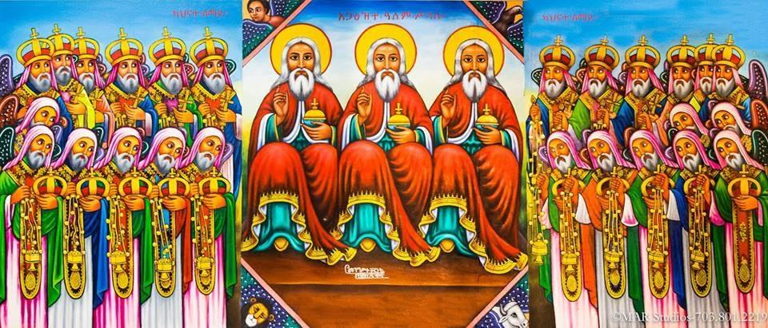
ናይ ኤርትራ ኦርቶዶክስ ተዋሕዶ ቤተ ክርስቲያን
Nay Eritrea Orthodox Tewahdo Biete Kristiyan
Eritrean Orthodox Tewahdo Church
‹#›

Slide 2
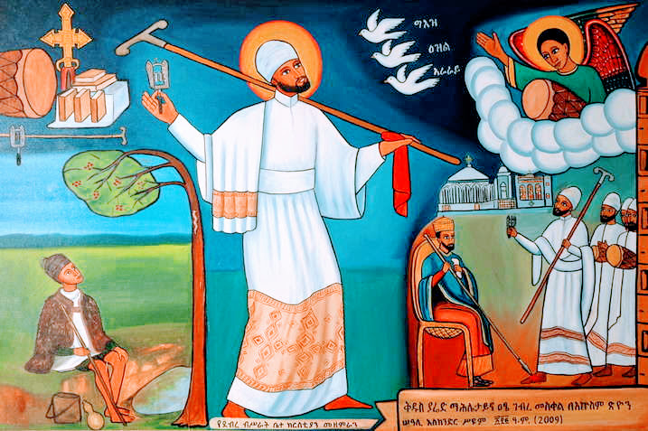
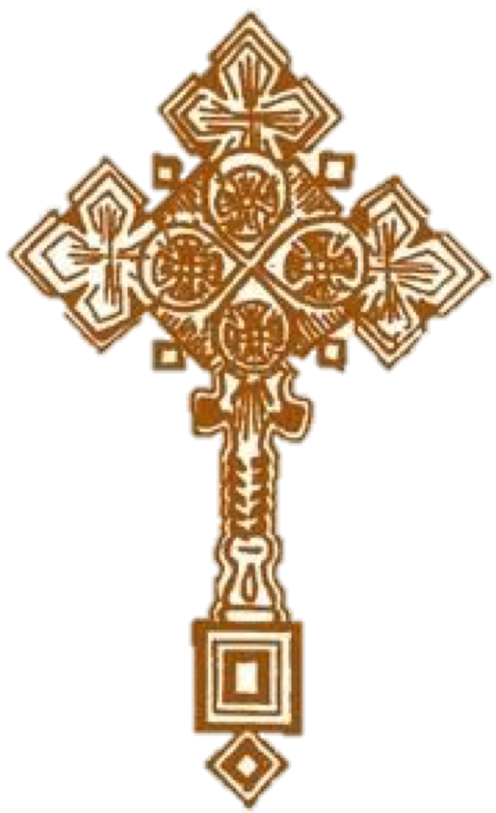
ምስባክን ንባብ ዘዓቢይ ጾም
Misbak’n Nibab zeAbiy Tsom
Psalms & Readings of Great Lent
መጽሕፈ ግጻዌ- Metshafe Gitsawie - Book of Lectionary
ዘውእቱ ኮከበ ጽባሕ - Kokeb Tsibah - The Star of Tomorrow
አሥመራ ኤርትራ | በ፲ወ፱፺፯ አመተ ምሕረት Asmara, Eritrea | 1997
‹#›

Slide 3
ዘወረደ | Ze-werede | He came down
ምስባኽን ንባብ Misbak Psalms & Readings
ገላ ፭፥፲፫- ፍጻ.ምዕ
1መል.ጴጥ. ፬፥፩-፲፩
ግብ.ሐዋ ፲፭፥፳፭-፴፭
ወንጌል ዮሐ ፫፥፲፡፳፩
Galatians 5:13-end
1st Peter 4:1-11
Acts 15:25-35
Gospel of St. John 3:10-21
ቅዳሴ | Qidasie | Divine Liturgy:
ዘእግዚእነ | Igzī’i | The Lord
ተቀነዩ ለእግዚአብሔር በፍርሃት። ወተሐሠዩ ሎቱ በረዓድ። አጽንዕዋ ለጥበብ ከመ ኢይትመዓዕ እግዚአብሔር።
መዝ ፪፥፲፩፡፲፪
teqeneyu leIgzīabhier be-firhat
we-tehaseyu lotu be-ra'id
atsni'iwa le-Tibeb keme īyitme'a Igzīabhier Mez 2:11-12
Serve the Lord with fear & rejoice with trembling kiss the son lest He be angry
Ps. 2:11-12
‹#›

Slide 4
ቅድስት | Qidist | Holy
ምስባኽን ንባብ Misbak Psalms & Readings
፩ይ ተሰ ፬፥፩፡፲፫
፩ይ ጴጥ ፩፥፲፫፡ፍጻ
ግብ ሕዋ ፲፥፲፮፡፴
ወንጌል ማቴ ፮፥፲፮፡፳፭
1st Thess. 4:1-13
1st Peter 1:13-end
Acts 10:16-30
Gospel of St. Matthew 6:16-25
ቅዳሴ | Qidasie | Divine Liturgy:
ዘአትናቴዎስ | Atnatiewos | Athanasius
እግዚአብሔርሰ ሰማያተ ገብረ። አሚን ወሠናይት ቅድሜሁ፡፡ ቅድሳት ወዕበየ ስብሐት ውስተ መቅደሱ።
መዝ ፺፮፥፭፡፮
Igzīabhierise semayate gebre amīn we-senayt qidmiehu qidisate webe-sibhate wiste meqdesu
The Lord made the heavens; Thanksgiving and beauty are before Him; Holiness and majesty are in His holy place
Ps. 96:5-6
‹#›

Slide 5
ምኩራብ | Mikurab | Temple
ምስባኽን ንባብ Misbak Psalms & Readings
ቆላስ ፪፥፲፮-ፍጻ
ያዕ ፬፥፩-፩፪
ግብ ሐዋ ፭፥፲፯-፴
ወንጌል ዮሐንስ ፪፥፲፪፡ፍጻ
Colossians 2:16-end
James 4:1-12
Acts 5:16-30
Gospel of St. John 2:12-end
ቅዳሴ | Qidasie | Divine Liturgy:
ዘእግዚእነ | Igzī’i | The Lord
እስመ ቅንአተ ቤትከ በልዐኒ፡፡ ትዕይርቶሙ ለእለ ይትዔየሩከ ወድቀ ላዕሌየ። ወቀጻዕክዋ በጾም ለነፍስየ።
መዝ ፷፱፥፱፡፲
“Because zeal for Your house has eaten me up, and the reproaches of those who reproach You have fallen on me. When I wept & chastened my soul with fasting” Ps. 69:9-10
Isme qinate bietike belAnī ti’irtomu le-ile yiteyeruke werqe la’ilieye
we-qetsa’ikiwa be-tsom le-nefsiye
‹#›

Slide 6
መፃጉዕ | Metsagu’i | Infirmity
ምስባኽን ንባብ Misbak Psalms & Readings
ዕብራ ፲፪፥፲፩- ፲፯
ያዕ ፭፥፲፬-ፍሜ
ግብ ሕዋ ፫፥፩-፲፪
ወንጌል ዮሐንስ ፭፥፩-፲፰
Hebrews 12:11-16
James 5:14-end
Acts 3:1-12
Gospel of St. John 5:1-25
ዘወልደ ነጎድጓድ | Welde negodgwad | John son of thunder
ቅዳሴ | Qidasie | Divine Liturgy:
እግዚአብሔር ይረድኦ ውስተ ዐራተ ሕማሙ። ወይመይጥ ሎቱ ኵሎ ምስካቢሁ እምደዌሁ። አንሰ እቤ እግዚኦ ተሣሃለኒ።
መዝ ፵፩፥፫፡፬
The Lord will strengthen him on his bed of illness You will sustain him on his sickbed. I said ‘Lord be merciful to me;’
Ps. 41:3-4
Igzīabhier yiredi’u wiste arate himamu we-yimeyiT lotu
Kulo mizgabīhu im-dewīhu anse ibie Igzīo tesahalenī
‹#›

Slide 7
ደብረ ዘይት | Debre Zeyt | Mt. of Olives
ምስባኽን ንባብ Misbak Psalms & Readings
፩ይ ተስ ፬፥፲፫-ፍጻ
፪ይ ጴጥ ፫፥፯-ፍጻ
ግብ ሐዋ ፳፬፥፲-፳፬
ወንጌል ማቴዎስ ፳፬፥፩-፳፰
1st Thess 4:13-end
2nd Pet. 3:7-15
Acts 24:10-24
Gospel of St. Matthew 24:1-36
ቅዳሴ | Qidasie | Divine Liturgy:
ዘአትናቴዎስ | Atnatiewos | St. Athanasius
Igzīabhierse gehade yimetsi’i weAmlakinehī īyaremim isat yinedid qidmiehu:
Our God shall come, and shall not keep silent; A fire shall devour before Him, and it shall be very tempestuous all around Him.
Ps. 50:3
እግዚአብሔርሰ ገሃደ ይመጽእ። ወአምላክነሂ ኢያረምም። እሳት ይነዽ ቅድሜሁ።
መዝ. ፶፥፫
‹#›

Slide 8
ገብር ሔር | Gebri Hier | Faithful Servant
ምስባኽን ንባብ Misbak Psalms & Readings
፪ይ ቆሮ ፬፥፩-፱
፩ይ ጴጥ ፪፥፲፩-፩፱
ግብ ሐዋ ፲፮፥፱-፲፰
ወንጌል ማቴ ፳፭፥፲፬-፴
2nd Corinthians 4:1-9
1st Peter 2:11-19
Acts 16:9-18
Gospel of St. Matt 25:14-31
ቅዳሴ | Qidasie | Divine Liturgy:
ባስልዮስ | Basiliyos | St. Basil
ከመ እንግር ፈቃደከ መከርኩ አምላኪየ። ወሕግከኒ በማዕከለ ከርሥየ። ዜኖኩ ጽድቀከ በማኅበር ዐቢይ።
መዝ. ፵፥፱-፲
I willed to do Your will, O my God, And Your law in the midst of my heart.” I proclaimed righteousness in the great church;
Ps. 40:9-10
Keme im-kirbe qalike mekerku Amlakīye we-higekenī be-ma’ikele getsiye zienoku tsidqeke be-bahr abiy
‹#›

Slide 9
ኒቆዲሞስ | Nicodemus
ምስባኽን ንባብ Misbak Psalms & Readings
ሮሜ ፯፥፩ -፲፬
፩ይ ዮውሃነስ ፬፥፩ -፲
ግብ ሐዋ ፭፥፴፬ -ፍጻ
ወንጌል ዮሐ ፫፥፩-፳፩
Romans 7:1-14
1st John 4:1-10
Acts 5:34-end
Gospel of St. John 3:1-12
ቅዳሴ | Qidasie | Divine Liturgy:
እግዝእትነ | Igzi’itine | Our Lady
You have tested my heart; you have visited me in the night; You have tried me and have found nothing; I have purposed that my mouth shall not transgress. Concerning the works of men.
Ps. 17:3-4
ሐወፅከኒ ሌሊተ ወፈተንኮ ለልብየ። አመከርከኒ ወኢተረክበ ዓመፃ በላዕሌየ። ከመ ኢይንብብ አፋየ ግብረ ዕጓለ እመሕያው።
መዝ ፲፯፥፫፡፬
hawetskenī lielīte we-fetenkoke le-libīye amekerkenī we-ītirikbe ametsa be-la’ilieye keme yinbib afuye gibre gwal ime hiyaw
Ps 127
‹#›

Slide 10
ሆሣዕና | Hosa’ina | Hosanna
ምስባኽን ንባብ Misbak Psalms & Readings
ዕብ ፱፥፲፩-ፍጻ
፩ይ ጴጥ ፬፥፩-፲፩
ግበ.ሐዋ ፳፰፥፲፯-፳፫
ወንጌል ዮሐንስ ፭፥፲፭-፳፱
Hebrews 9:11-end
1st Pet 4:1-12
Acts 28:17-23
Gospel of St. John 12:1-2
ጎርጎርዮስ (ዘኑሲስ) | Gorgoryos ze-nisa | Bishop Gregory of Nyssa
ቅዳሴ | Qidasie | Divine Liturgy:
እምአፈ ደቂቅ ወሕፃናት አስተዳሎከ ስብሐተ ። በእንተ ጸላዒ። ከመ ትንሥቶ ለጸላዒ ወለገፋዒ።
መዝ ፰፥፪
Im-afe deqīq we-hitsanat astedaloke sibhat
be-inte tsela’ī keme tinsiTo le-tsela’ī wele-gefa’ī
Out of the mouth of babes & nursing infants you have ordained strength, because of Your enemies, that You may silence the enemy and the avenger. Ps. 8:2
‹#›

Slide 11
ትንሣኤ | Tinsa’ie | Holy Resurrection
ምስባኽን ንባብ Misbak Psalms & Readings
፩ይ ቆሮ ፲፭፥፳-፵፯
፩ይ ጴጥ ፫፥፲፭-ፍጻ
ግብ ሐዋ ፪፥፳፪፡፴፮
ወንጌል ዮሐንስ ፳፥፩፡፲፰
1st Cor 15:20-47
1st Pet 3:15-end
Acts 2:22-36
Gospel of St. John 20:1-18
ቅዳሴ | Qidasie | Divine Liturgy:
ዘዲዮስቆሮስ | Dīyosqoros | St. Dioscoros
ዛቲ ዕለት እንተ ገብረ እግዚአብሔር። ንትፈሣሕ ወንትሐሠይ ባቲ። ኦ እግዚኦ አድኅንሶ።
መዝ ፻፲፯፥፳፬፡፳፭
zatī ilet inte gebre Igzīabhier nit’fesah we-nit’hasey batī, o Igzīo adhin’so
Ps 117:24-25
This is the day the Lord has made; we will rejoice and be glad in it. Save now, I pray O Lord;
Ps. 117:24-25
‹#›

