Slide 1
The Lights of Our Church Trivia

Slide 2
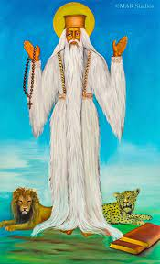
1) Which saint is this?
St. George
St. Yared
Aba Gebre Menfes Qidus
St. Peter

Slide 3
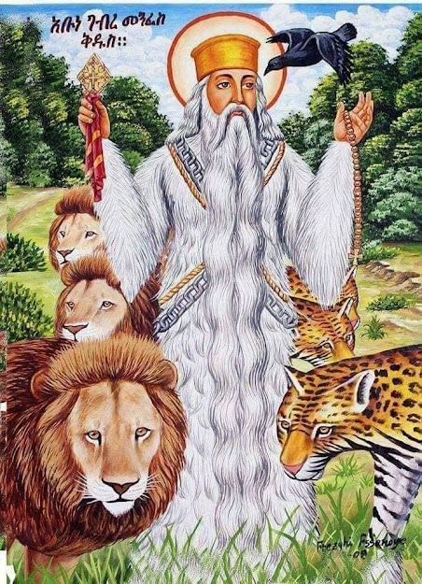
Answer : Abune Gebre Menfes Qidus

Slide 4
2) How long were Saints Mary, Salome, Joseph and our Lord Jesus in exile?
3 months
12 years
3.5 years
Until Christ started His ministry

Slide 5
Answer : 3.5 years

Slide 6
3) Which saint is referred to as the Holy of Holies and the Purest of the Pure?
Adam and Eve
Saint Peter
The Virgin Saint Mary
Joachim and Anna

Slide 7
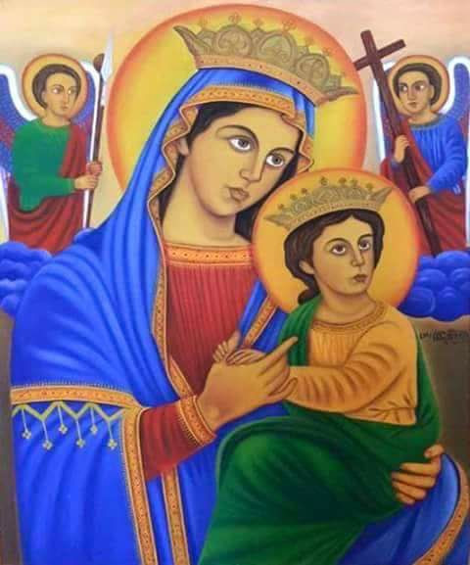
Answer :The Virgin Mary

Slide 8
4) Which saint had a beautiful palace built for her to become the leader or a blessed gathering of devout virgins?
St. Hanna
St. Elizabeth
St. Demiana
St . Mary of Nazareth

Slide 9
Answer : St. Demiana

Slide 10
5) Which 6 winged saint converted many people to Christianity, drove out evil spirits, raised the dead and could foretell events?
St. Jared
St. George
Abune Gebre Menfes Qidus
Abune Tekle Haymanot

Slide 11
Answer : Saint Tekle Haimanot

Slide 12
6) Which apostle had faith, zeal and love for God and for this reason was made chief of the apostles?
A. St.Peter
B. St. Paul
C. St. John
D. St. Matthew

Slide 13
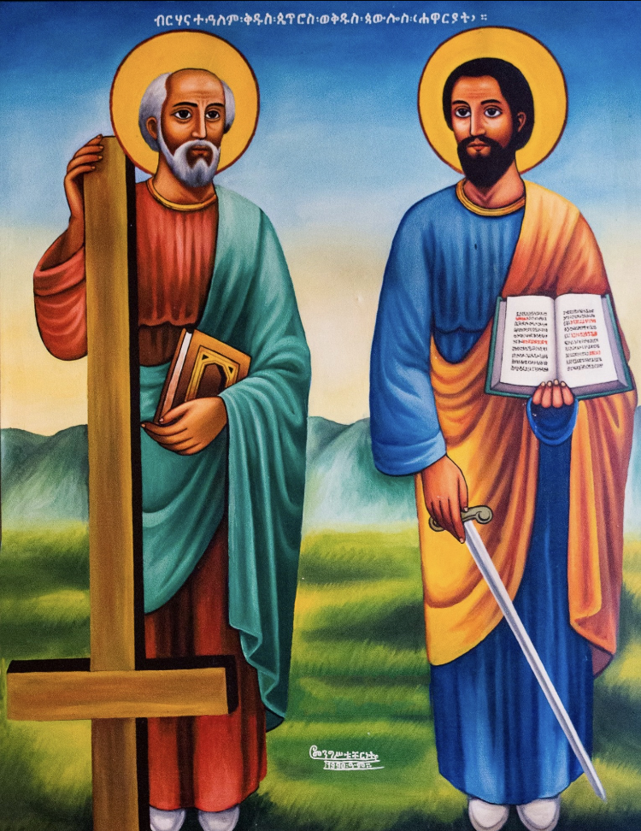
Answer : St. Peter

Slide 14
7) Which Gospel writer never died?
Matthew
Mark
John
Luke

Slide 15
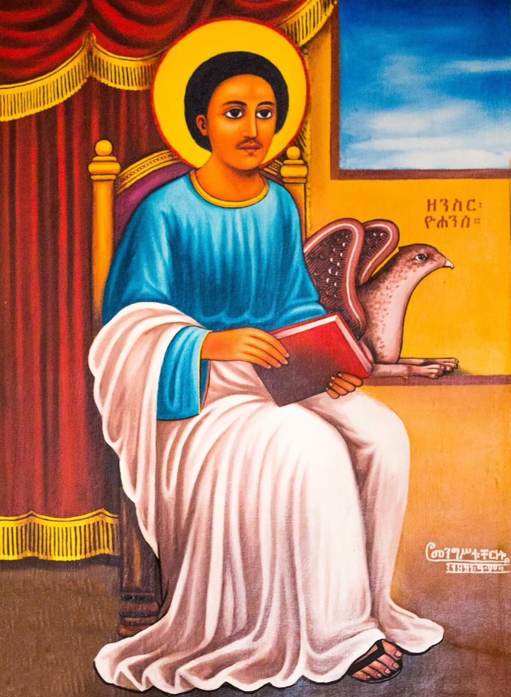
Answer : John the beloved

Slide 16
8. Which saint was there to wrap the body of Our Lord after His crucifixion?
St. Paul
St. Simeon
St Joseph of Arimathea
St Matthew

Slide 17
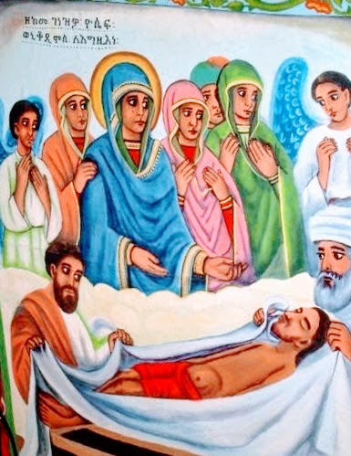
Answer : St Joseph of Arimathea

Slide 18
9. Who is the first bishop to bring baptism & Holy Communion to our church?
Abba Qierlos
Abba Selama
Abba Shenouda
Abba Philipos

Slide 19
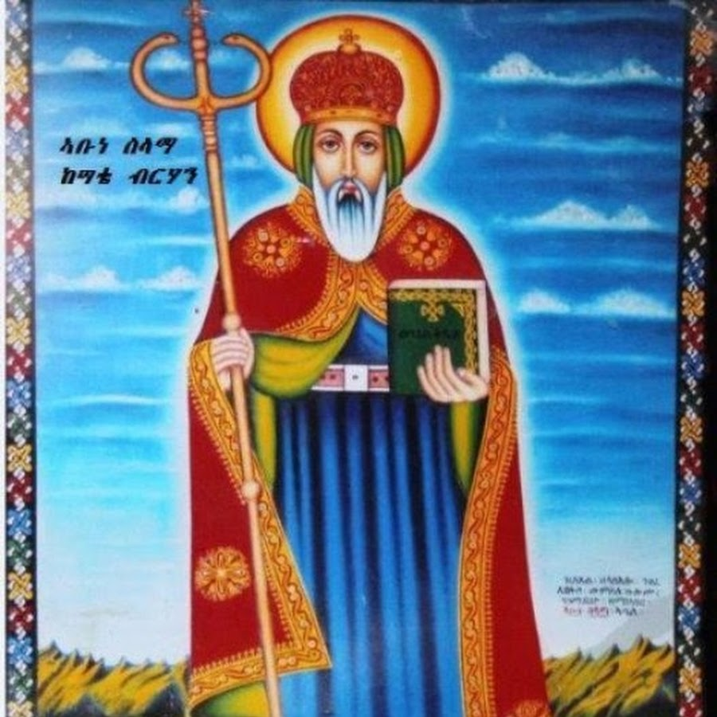
Answer: Abba Selama

Slide 20
10. Which Saint was tortured by an emperor and had his head cut with the blade of sword?
St. Tekle Haimanot
St. Yared
St. George
St. Peter

Slide 21
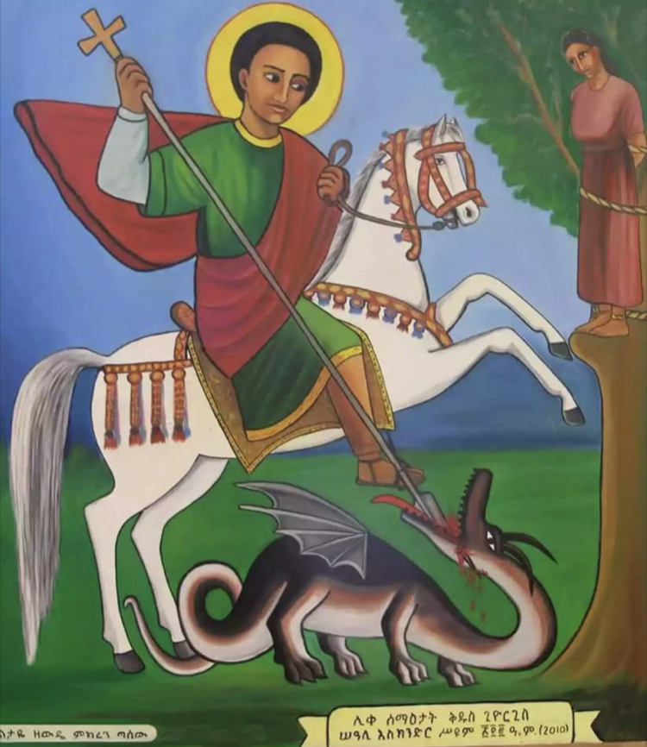
Answer : St.George

Slide 22
11. ﻿Which saint had three birds sent from God to take him to Jerusalem to learn songs and later arranged hymns to separate into three different modes: ordinary days, fasting days and festivals?
St . Francis
St . Yared
St. George
St . Abune Aregawi

Slide 23
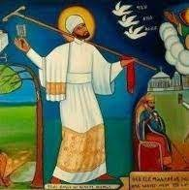
Answer: ﻿St. Yared

Slide 24
12. Who was the saint that created Widase Maryam (praises of Mary) prayer?
Abba Hiryaqos
Saint Ephraim
Saint Luke
Abba Giyorgis
Saint Mary

Slide 25
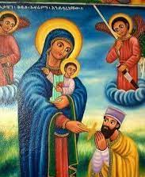
Answer:
St. Ephraim the Syrian

Slide 26
Bonus Questions

Slide 27
1. Why was halloween celebrated 2000 years ago?
To celebrate evil spirits
Or
Have fun dressing up & getting candy

Slide 28
Answer :
To celebrate the dead

Slide 29
2. Is Halloween referenced in the Old Testament or the New Testament?

Slide 30
Answer : NEITHER!

